Slide 1

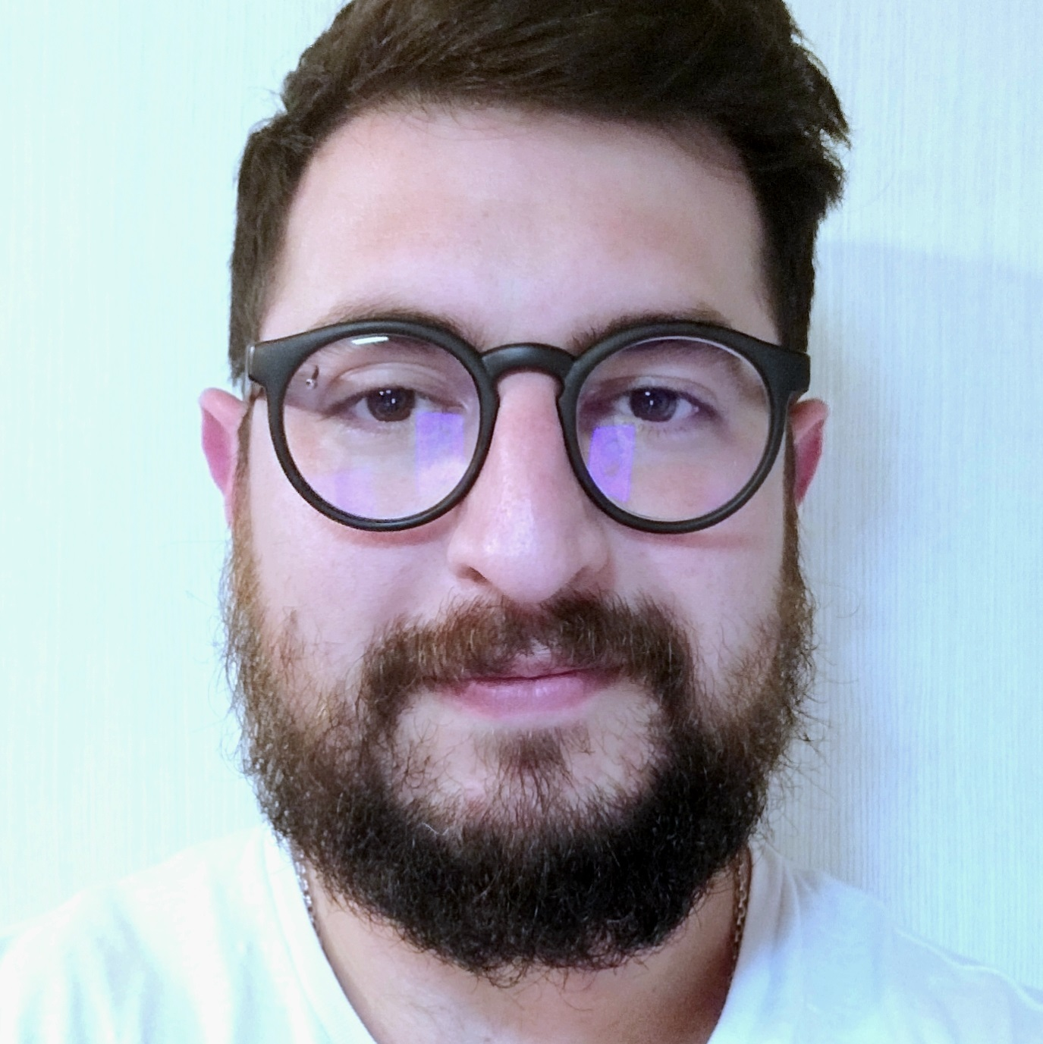
EXPERIENCIA
Leandro Bravo
Desarrollador de Aplicaciones Agénticas – Accenture (2026)
Desarrollo de sistemas de agentes con Google ADK y OpenAI en Python
Arquitectura de agentes desacoplados comunicados mediante A2A
Tool calling hacia APIs y bases de datos mediante mocks de servicios
Contenerización con Docker y evaluación con ADK EvalKit
Ingeniero de Datos Python – Accenture (2024–2026)
Desarrollo de pipelines ETL en AWS con Glue, Lambda, Athena y S3
Procesamiento de datos geográficos de múltiples fuentes
Preparación de datasets para frontend analítico
Desarrollador GenAI – NTT Data (2023–2024)
Integración de Azure OpenAI en chatbot mediante FastAPI
Implementación de RAG con LangChain y Chroma
Casos de uso: atención al cliente y búsqueda en SharePoint
Uso de Vertex AI para conversión de PDF a HTML
Practicante de Ciencia de Datos – Froneus (2022–2023)
Mantenimiento de modelo de clasificación de texto (scikit-learn) para voice bot
Desarrollo de pipeline ETL en PySpark (Databricks) de MongoDB a PostgreSQL
Programador Python – Forian (2020–2022)
Desarrollo de dashboard con Django + PostgreSQL
Optimización de base de datos y pipelines ETL en Python
Modelo de clasificación de texto en producción (scikit-learn)
Practicante de Ciencia de Datos – BNP Paribas Cardif (2019–2020)
Modelos predictivos con scikit-learn y XGBoost para reclamaciones
Reglas de asociación (Apriori) para análisis de campañas
Practicante de Ciencia de Datos – Overactive (2018–2019)
Clasificación de texto con scikit-learn para moderación de comentarios
Practicante de Ciencia de Datos – Bizmetriks (2018)
Segmentación de clientes con K-Means
ETL en Python consumiendo API REST (HAL)
Análisis estadístico de churn y deuda de clientes
Data Eng, Mgmt & Gov Specialist
Technology / Data & AI
leandro.bravo@accenture.com
Buenos Aires, Argentina
PERFIL PROFESSIONAL
AREAS DE EXPERIENCIA
My professional experience encompasses creating automations, full-stack apps and developing ETL jobs, reports and control panels. I am a creative person who enjoys a good challenge and learning new things.
HABILIDADES Y HERRAMIENTAS
Python Backend: FastAPI, Sqlalchemy, Flask, Django, Pydantic.
Python DS: Pandas, Scikiit-learn, Scipy, Numpy, PySpark, Seaborn, h3, GeoPandas, Shapely
GenAI: OpenAI, VertexAI, Langchain, LangGraph, ADK, Pydantic AI
Databases: Postgresql, MySQL, MongoDB, ArcGIS
Containerization: Docker, Compose, Rancher, Kubernetes.
Cloud: Azure AKS, Azure WebApp Service, Azure OpenAI Servcice, AWS Glue & Lambda, GCP VertexAI.
Otras: Nodejs
EDUCACION
Licenciatura en Sistemas (Incompleto)
ESPECIALIZACIONES
Cert en Cs de Datos en Digital House
Cert en Cs de Datos en Correlation One
IDIOMAS
INDUSTRIA
Ingles (avanzado)
Portugues (princpiante)
Español (nativo)
Seguros
Financiera
Energía
Accenture Technology Data & AI

Slide 2
EXPERIENCIA
Leandro Bravo
Agentic Applications Developer – Accenture (2026)
Developed an LLM-based agent system using Google ADK and OpenAI in Python.
Designed decoupled agents communicating through the A2A protocol.
Implemented tool calling to APIs and databases using service mocks.
Containerized with Docker and evaluated agents using ADK EvalKit.
Python Data Engineer – Accenture (2024–2026)
Built ETL pipelines on AWS using Glue, Lambda, Athena, and S3.
Processed geospatial data from multiple sources.
Prepared datasets for an analytical frontend.
GenAI Application Developer – NTT Data (2023–2024)
Integrated Azure OpenAI into a chatbot using FastAPI.
Implemented RAG pipelines with LangChain and Chroma.
Use cases: customer support and SharePoint knowledge base search.
Used Vertex AI for PDF-to-HTML document transformation.
Data Science Intern – Froneus (2022–2023)
Maintained a text classification model (scikit-learn) for a voice bot.
Built a PySpark ETL pipeline on Databricks from MongoDB to PostgreSQL.
Python Developer – Forian (2020–2022)
Developed a Django + PostgreSQL analytics dashboard.
Implemented Python ETL pipelines and database performance optimizations.
Deployed a production text classification model (scikit-learn).
Data Science Intern – BNP Paribas Cardif (2019–2020)
Built predictive models using scikit-learn and XGBoost for insurance claims.
Applied Apriori association rules for marketing campaign analysis.
Data Science Intern – Overactive (2018–2019)
Developed text classification models (scikit-learn) for comment moderation.
Data Science Intern – Bizmetriks (2018)
Performed customer segmentation with K-Means.
Built a Python ETL pipeline consuming a HAL REST API.
Conducted statistical analysis for churn and debt prediction.
Data Eng, Mgmt & Gov Specialist
Technology / Data & AI
leandro.bravo@accenture.com
Buenos Aires, Argentina
PROFESSIONAL BACKGROUND
AREA OF EXPERTISE
My professional experience encompasses creating automations, full-stack apps and developing ETL jobs, reports and control panels. I am a creative person who enjoys a good challenge and learning new things.
HARD/SOFT SKILLS & TOOLS
Python Backend: FastAPI, Sqlalchemy, Flask, Django, Pydantic.
Python DS: Pandas, Scikiit-learn, Scipy, Numpy, PySpark, Seaborn, h3, GeoPandas, Shapely
GenAI: OpenAI, VertexAI, Langchain, LangGraph, ADK, Pydantic AI
Databases: Postgresql, MySQL, MongoDB, ArcGIS
Containerization: Docker, Compose, Rancher, Kubernetes.
Cloud: Azure AKS, Azure WebApp Service, Azure OpenAI Servcice, AWS Glue & Lambda, GCP VertexAI.
Other: Nodejs
EDUCATION
Bachelor in Computer Science (Incomplete)
SPECIALIZATIONS
Data Science Certificate in Digital House
Correlation One DS Certificate
LANGUAGES
INDUSTRY
English (advanced)
Portuguese (beginner)
Spanish (native)
Insurance
Financial
Energy
Accenture Technology Data & AI

